Slide 1
Understanding solar panel adoption using the DeepSolar++ dataset
Alanoud Alhakbani, Luca Montanelli, and Mahmoud Ramadan

Slide 2
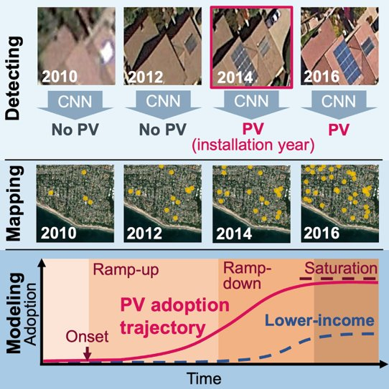
DeepSolar++​
Created a CNN to for detecting solar panel from satellite imagery (2010-2016)
Built a nearly complete solar panel numbers per census tract database for the contiguous US
  Fitted a Bass model of technology adoption​
Yu J, et al. "DeepSolar: A machine learning framework to Efficiently Construct a Solar Deployment Database in the United States." Joule (2018)
Wang Z, et al. “DeepSolar++: Understanding residential solar adoption trajectories with computer vision and technology diffusion models.” Joule (2022)

Slide 3
Project goal
Understanding the factors contributing to solar panel adoption by predicting the number of solar panels per building in 2016

Slide 4
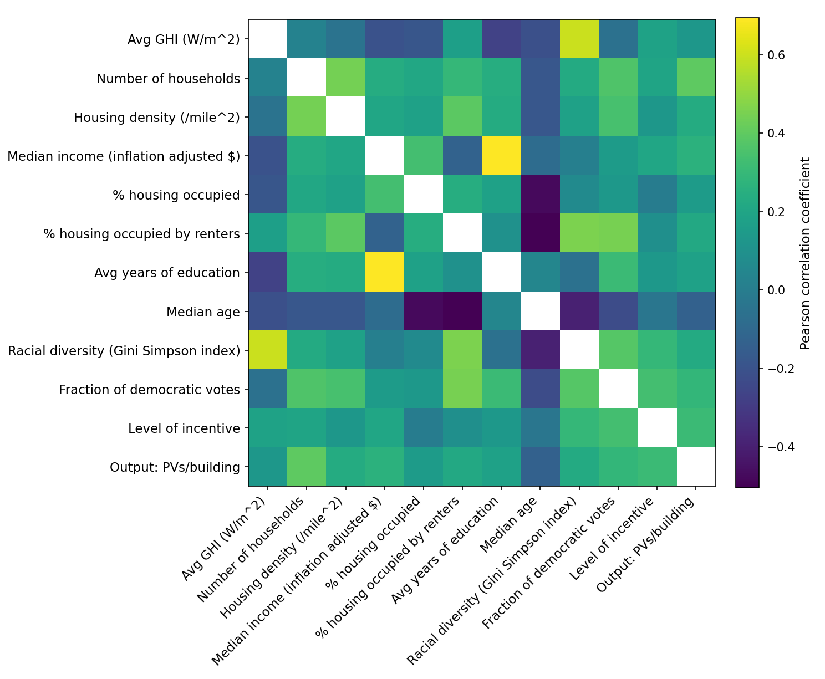
2016 features of the DeepSolar++ dataset
Data is subdivided by census block
We aggregate it by county
Data contains for 2016:
  Number of solar panels
  Geographic and environmental information including global horizontal irradiance (GHI)
  Demographic information including racial diversity (Gini index)
  Economic factors, such as property value, income, and employment

Slide 5


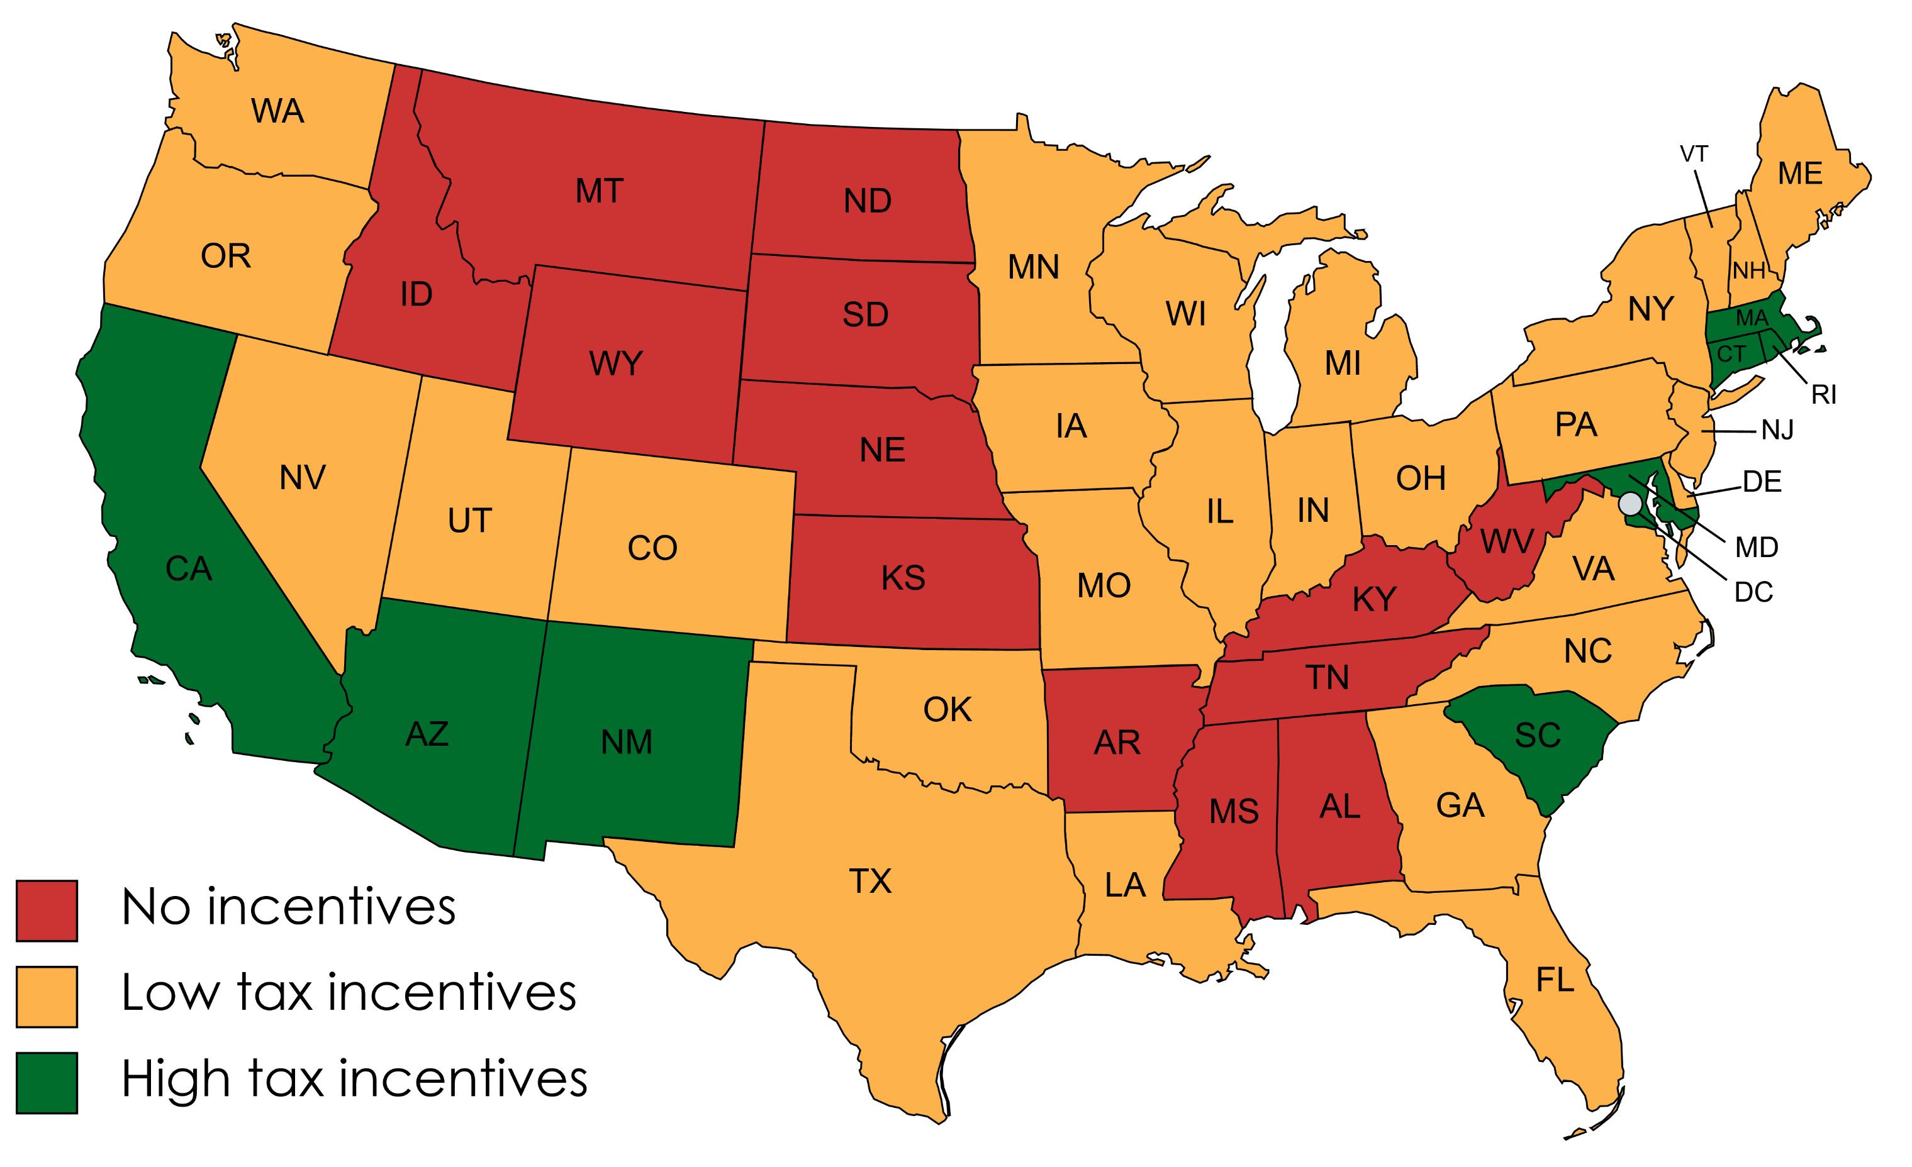
Added feature – State incentives for PV
Incentives information obtained from and
Manually label/ classify all states:
  No state incentive
  Low state incentive (only one of the following: tax-free sale, net metering, low-interest loans, exemption from property tax)
  High state incentives (rebates, grants, or
  more than one tax incentive)

Slide 6
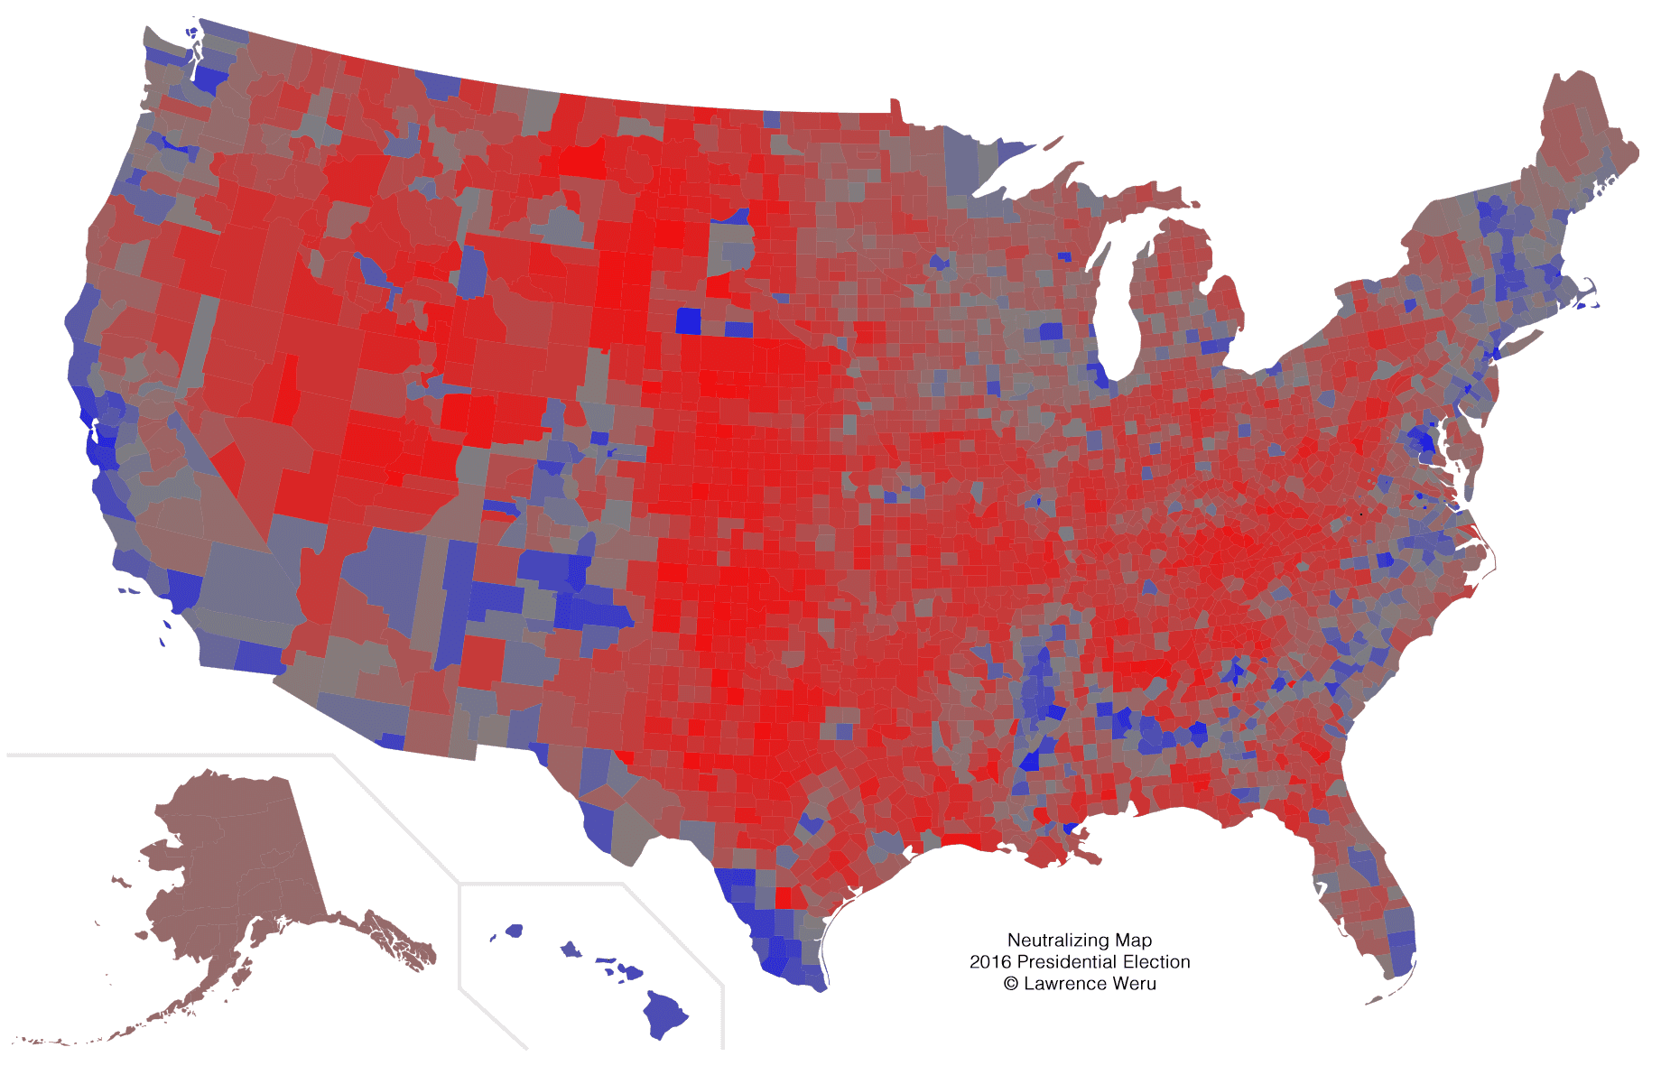
Added feature – Partisan Index
Added results of 2016 elections
Fraction of votes for the democratic party per county
This ignores independent votes

Slide 7
Added features
Added our own features to the dataset to improve model performance
State tax incentives for PV
Fraction of democratic votes by county

Slide 8
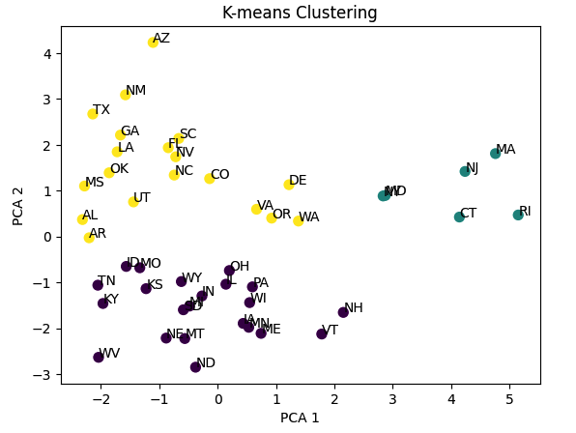
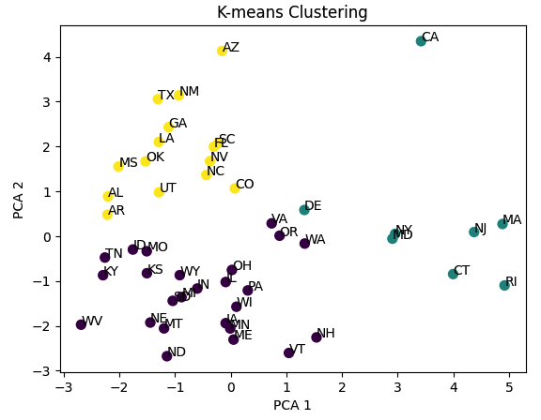
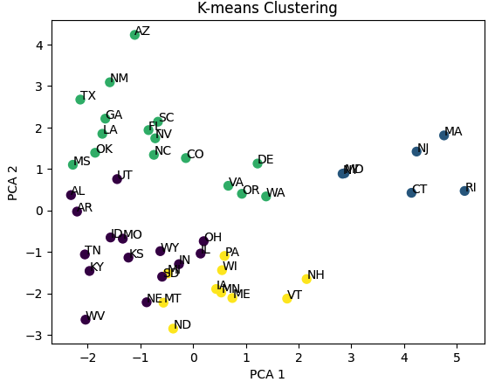
K-means clustering on features
California is an outlier state
3-4 clusters can describe state feature distribution
Sunny states (top left)
Midwestern sunny states (bottom left)
Northeastern states (top right)

Slide 9
Preliminary model scoring
Simple testing of different models to see where to focus​
Decided to investigate RandomForest, XGBoost, and NN more deeply
 | Lasso | Ridge | RandomForest | GradientBoosting | XGBoost | NN
Without state features | 0.1770 | 0.1796 | 0.3075 | 0.2124 | 0.3566 | 0.2806
With state feature | 0.6550 | 0.6347 | 0.7232 | 0.6932 | 0.7079 | 0.5524
Only y>0 | 0.4963 | 0.4899 | 0.7106 | 0.7532 | 0.8100 | 0.7033

Slide 10
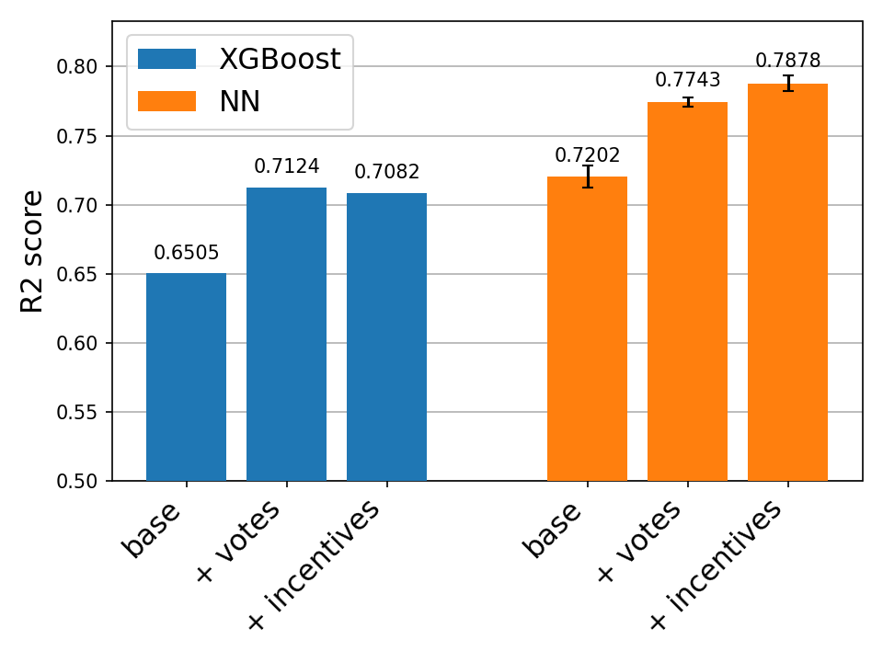
Hyperparameter tuning​
Performed Bayesian optimisation with cross-validation to find the best hyperparameters​
RandomForest:​
  Did not perform better than previously​
XGBoost:​
  Performed best with add vote feature​
NN:​
  Simple fully connected layers
  Best performing model​

Slide 11
Finding the best model​
Performed Bayesian optimisation with cross-validation to find the best hyperparameters​
XGBoost:​
  Performed best with add vote feature​
NN:​
  Simple fully connected layers
  Best performing model​

Slide 12
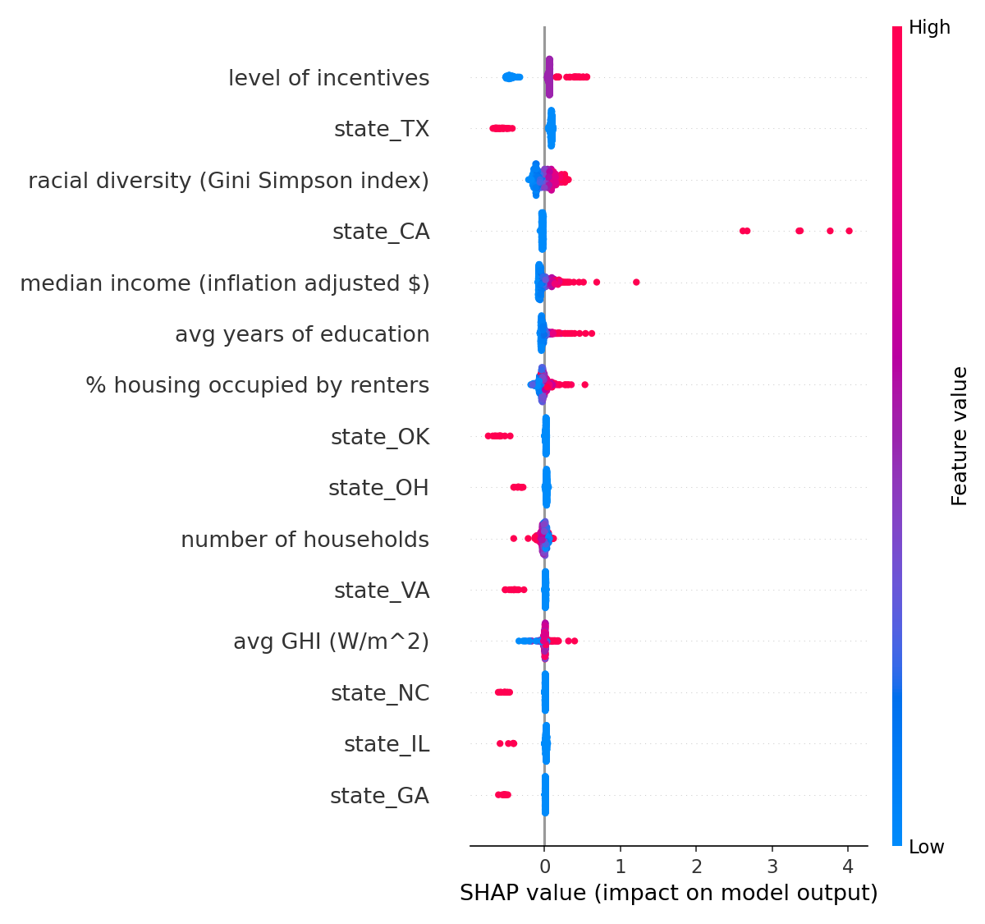
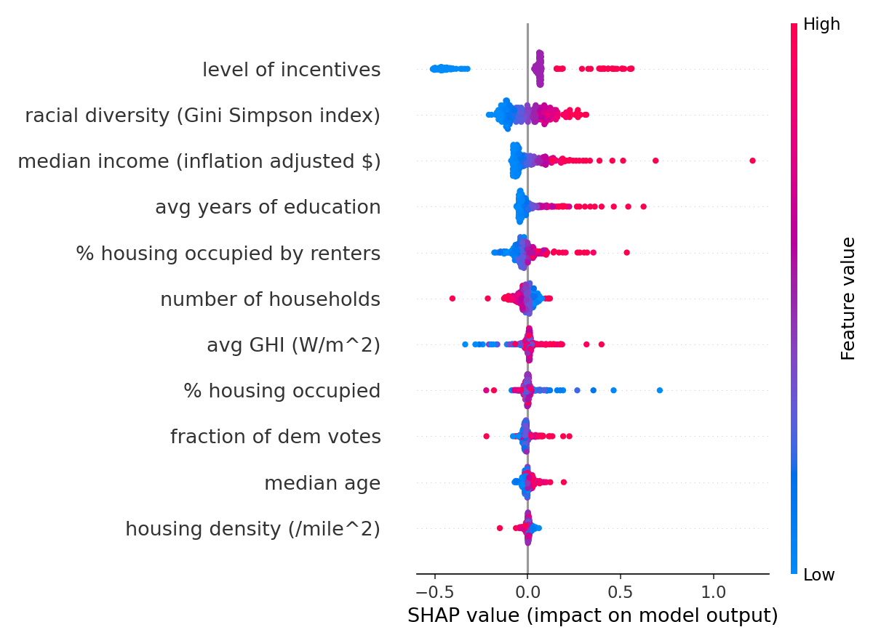
Interpretability
SHAP values were used to interpret the output of the best NN​
SHAP values are based on cooperative game theory​
They provide interpretability for hard to explain models​

Slide 13
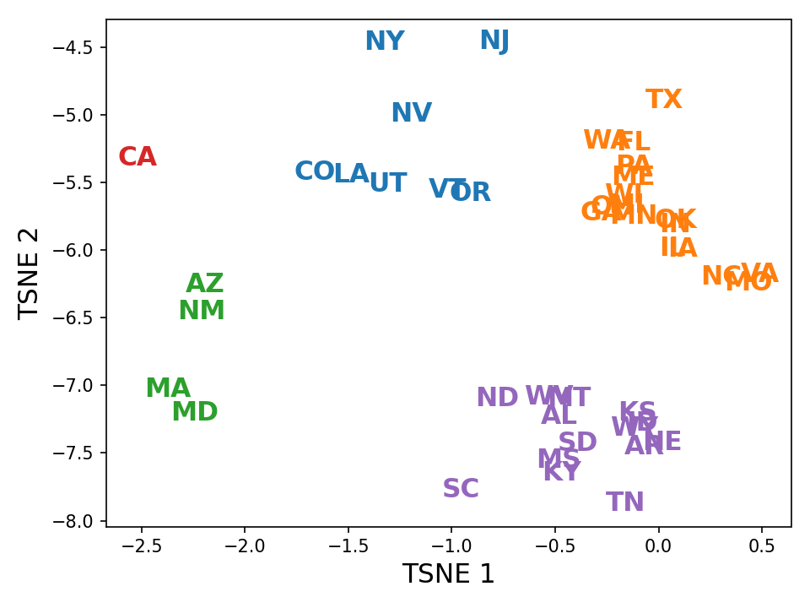
Varying state responses
For each state we can get the SHAP values and plot them in lower dimension
Like coefficients, SHAP values allow us to understand how different states behave

Slide 14
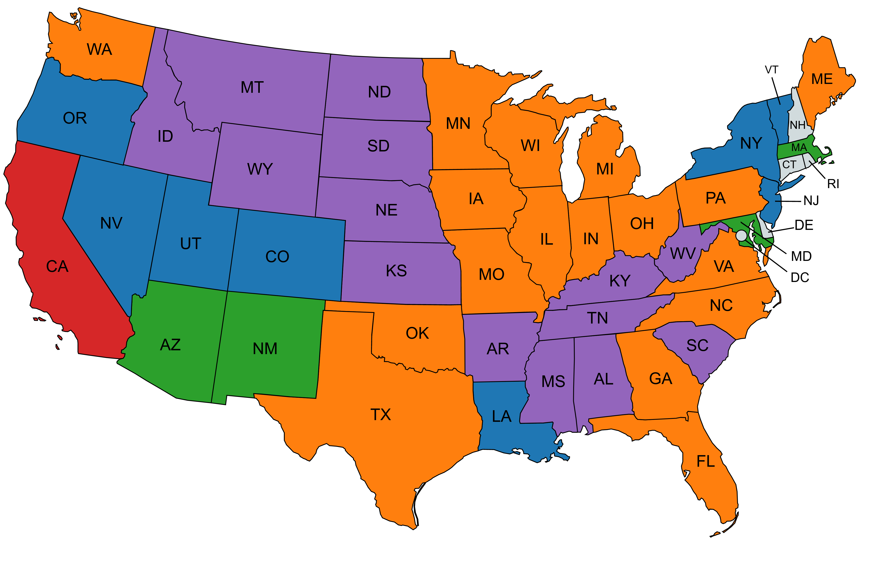
Varying state responses
Medium incentives
Higher adoption
Dem vote contributes more
Incentives contribute less
Medium incentives
Very low adoption
Income contributes less
Dem vote contributes less
Incentives contribute less
Higher incentives
Much higher adoption
Age contributes more
Diversity contributes more
Income contributes more
Lower incentives
Very low adoption
GHI contribute less
Incentives contribute more
Higher incentives
Higher adoption
Incentives contribute more
Dem vote contributes more

Slide 15
Time series forecasting
Our goal is to predict the adoption rate on a county level (#PV installed/#houses)
Therefore, we also used time-series approaches to predict the number of residential PVs for on a county level by 2017
In this approach we used bidirectional LSTM trained using both cumulative number of PVs installed time-series and combining it with other tabular data we have in our dataset

Slide 16
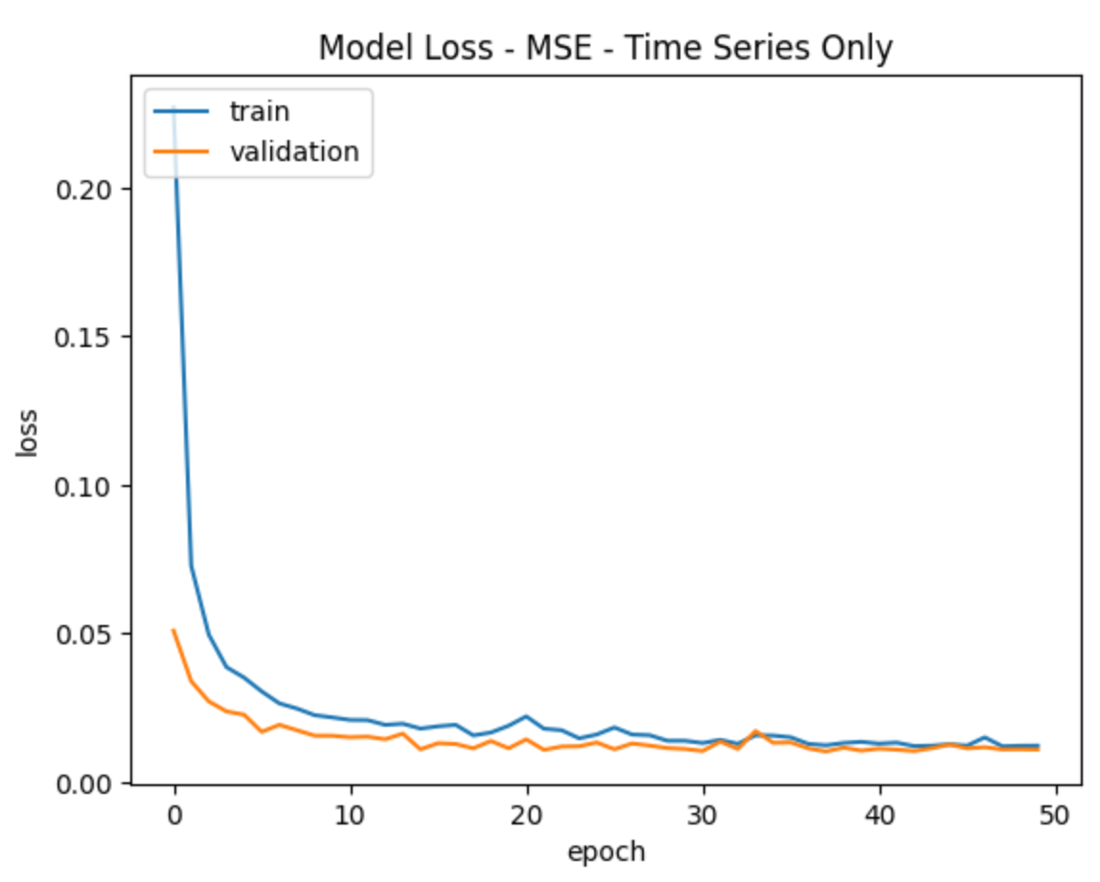
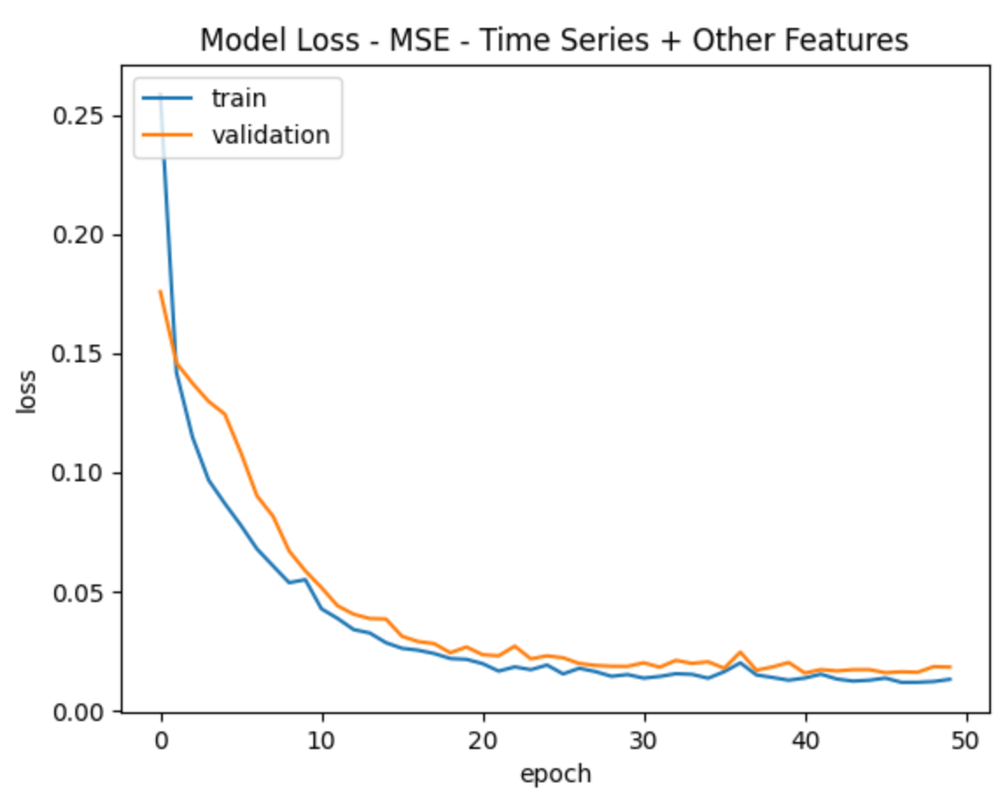
Time series forecasting using LSTM
Dataset | Training loss (50 epochs) | Validation loss | Testing loss | R2 on test data
Time series only | 0.0123 | 0.0109 | 0.01082 | 0.98983
Time series + additional features | 0.0130 | 0.0182 | 0.01225 | 0.98810

Slide 17
Limitations and future work​
Data is from 2016​
Dataset mostly consists of low numbers (38.80% of counties have no solar panels)​
Could split into presence of solar panels or not and fit two models:​
  One to predict presence of solar panels​
  Another to predict the number of solar panels when they are present​
Results are highly dependent on train/test split​
Time series performs better on PV-time series data compared to PV+other features

